Slide 1
IE260 Lecture 6: Tree
Il-Chul Moon
Department of Industrial and Systems Engineering
KAIST
icmoon@kaist.ac.kr

Slide 2
Short Recap

Slide 3
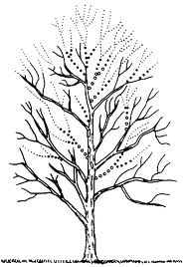
Tree as an Abstract Data Type
Tree structure
Abstract data type
Data stored
As a tree structure
Operations
Ordinary data structure operations just as linked lists
Insert
Delete
Search
Special searching approaches for trees and networks
Traverse
Notes:
Now, we’re going to explore the structure of the tree, an abstract data type.
What type of tree it is?
This looks just like an ordinary tree you can find anywhere.
One notable point is that it is upside-down.
The figure takes an upside-down form.
In the field of computer science, especially data structure, the typical form of a tree takes an upside-down shape. The roots are located above, and the branches and leaves are below.
In a computer, it can be expressed like below.
This tree has roots, with the bottom part above instead. Various branches spread from the stump, and leaves grow from the branches.
A tree structure is a type of abstract data type that’s used to store data.
The operations of a tree structure include those supported by basic data structures.
For instance, what types of operations did we see in a linked list?
To briefly review that topic, we were able to insert data with a linked list.
By insert, we were able to cut the connection here and add a new node.
It was possible to conduct a search for 4 nodes in this order.
If we were to remove it, we just had to add a new connection to this node and sever the connection here.
A linked list supports insert, delete, and search.
These things should be supported in a tree.
However, a tree has a peculiar structure.
For instance, it can issue a command like this.
When we arrange all the content in the linked list, the values of 1, 2, 3 will be printed out for this part, which is disconnected.
In other words, it’s a form of traversing that lists up all the data.
However, there is no need to learn traversing for a linked list. That’s because it finds and arranges items, one by one.
Does this also hold true for a tree?
If it is like this, we would put it out to find No. 2 and No. 3 below. Again, No. 4, No. 5, No. 6, and No. 7 are underneath.
Since it doesn’t have the linear structure of a linked list, drawing each data may lead to the generation of many variations.
The point is that traversing may be defined in a range of ways.
Thus, we will cover various forms of traversing to define various tree structures.

Slide 4
Terminologies of Tree Structure (1)
Tree
Root
A
Edge
Node
Internal Nodes
B
C
D
Siblings
A is D’s Parent
D is A’s Child
E
F
G
H
Leaves, Terminal Nodes
Notes:
Now we’ve learned about the basic concept of a tree.
As the tree is a newly introduced concept, we’ll go over some related terms that will prove useful.
This is a tree that features an exponentially increasing number of nodes due to having multiple nexts from a single node, as shown here.
In the tree structure, a node is what is pointed by a single next. This arrow here is called an edge.
This particular node at the top of the tree is specifically called a root.
It is similar to the way the head and tail are determined in a linked list.
In one class called “tree”, as long as we know the root, we can always store data in the structure by using “search”, “insert”, and “delete”.
We can generate a special node called “root”.
A and D are connected by the edge. A is the parent of D, so D becomes the child of A.
This term is used when the node is directly connected.
This is an analogy that we can think of in our daily lives.
We’re going to refer to the collection of children that share the same parent as siblings.
As the parent of E, F, G, and H is B, which means that they form the multiple nexts of B, we are going to call them siblings.
In the tree structure, there are some cases when one node no longer has another next.
The nexts of these nodes contain garbage values.
In other words, the ones at the bottom layer do not have any path that you can search any deeper.
That’s because they don’t have any tree nodes to be pointed by other nexts.
So, we call E, F, G, H, C, and D at the bottom layer the leaves of a tree.
They are also known as terminal nodes.
In this context, nodes other than the leaves of a tree are referred to as internal nodes as they are present inside this tree.

Slide 5
Terminologies of Tree Structure (2)
Path to E
A
Ancestors of E
Descendants of A
B
C
D
E
F
G
H
Notes:
When we refer to the descendants of A, we’re talking about all the children of A and the children of A’s children.
If we trace upward, past the immediate parents such as B, C, D, E, F, G, and H, we will finally meet A.
We will call the forefathers of E, E’s ancestors.
Although E has only one parent, B, its ancestors include B and A.
H has the same ancestors.
C has only one ancestor, A.
Now we are able to define the path.
Now, the concept of a path is very important.
The path refers to the route that ensures the shortest edges from the location of the root to a specific node.
The path of E will always start from root A. It then goes through A and B, which is the shortest path available to get to E, and then reaches E.
This is called the path of E.
It goes from A to B and B to E.
The length of the path for the node E is 2.

Slide 6
Terminologies of Tree Structures (3)
Size of tree
A
Depth and level of B
B
C
D
Height of tree
E
F
G
H
Degree of B
Notes:
After defining what is a path, we are now able to define what is a depth or level.
The length of the path to reach the node B is 1.
So, the depth of B is 1.
The depth of A is 0.
Also, the depth of E is 2.
To sum up, the depth of a specific node is the length of the path to the node.
Now, how can we decide the height of a tree?
The height of a tree is equivalent to the maximum path length.
The length of the longest path is the path to reach E or F, G, and H, which is then 2.
So, the height of the tree is 2.
We can also determine what is a degree.
A degree refers to the number of nexts that a certain node can have. The degree of B is 4.
The size of the tree is defined by the number of nodes on the tree.
It can also be the number of the stored nodes.
In this case, the size of a tree is 8.

Slide 7
Terminologies of Tree Structure (4)
Full Tree
Complete Tree
A
A
B
C
B
C
Full tree
D
E
F
G
D
E
Filled from left
Notes:
Finally, let’s review the overall shape of a tree.
Although there trees generally come in various shapes, there are also trees of special forms.
The leaves of the tree here are located at the same level. For the internal nodes, all nexts here point to the next nodes.
The internal nodes have full next nodes, while the terminal nodes have no next nodes.
A tree with a triangle shape is called a full tree.
The height of the tree is 2 and its degree is 2. That means there is no more space to store data.
To add one more, we have to increase the depth.
That is called a full tree.
Although different from a full tree, another tree that deserves our attention is a complete tree.
A complete tree has a full tree structure till one depth just before.
This is a full tree. The tree with a structure of nodes filled up from the far left to right is called a complete tree.
In other words, the above is a full tree. It is a complete tree if each node is filled from the left side.
For instance, if there is one additional node here by the next reference of C, it is not a complete tree.
That’s because the node is not attached to the left-hand side of C, but the right-hand side.
On the other hand, if a node is attached to the left-hand side, rather than right-hand side, it is a complete tree. That’s because its nodes are in the process of being filled up from the left side.
Therefore, we could discern the shape of a tree between full tree and complete tree based on their branches.

Slide 8
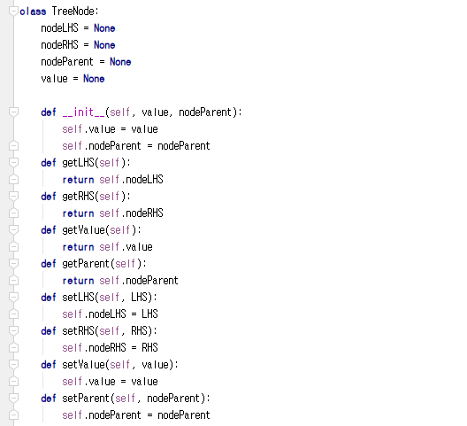
Implementation of Tree Node
Has three references
Left hand side (LHS)
Right hand side (RHS)
Its own value
Its parent node
Not implemented here, but
LHS stores
Values have lower than its own value
RHS stores
Values have higher than its own value
Just as we all know that the department stores do not have a restroom on the first floor
Other than four references,
Simple get/set methods
What are the get/set methods?
Coming from encapsulation
Four references
Notes:
To better understand the concept of a binary search tree, let’s consider its use in actual implementation.
First off, we need the nodes of a tree to construct a tree.
Suppose that there is a pointer directed to the reference of the parent in this node.
We would assume that we have the left and right here, along with the value pointing at values.
Thus, we will define a tree node with four references.
The four references point to the left-hand side (LHS), right hand side (RHS), its own value, and the parent.
Let’s say that the LHS always has a smaller value. RHS always indicates the node that points at a larger value.
Then, we would define a method that could “get” and “set” the references.
This example pretty much covers the simple definition of a tree node.

Slide 9
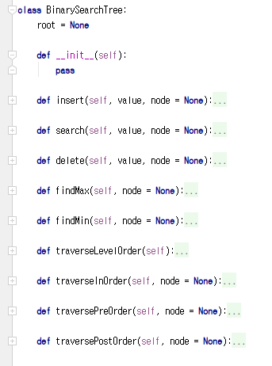
Implementation of BST
Tree instance
A (root)
B
C
D
E
F
BST handles the data stored through its root
Root has its own value
Tree instance access to the root
Only through the root, the tree instances access to the descendant nodes of the root
Notes:
Next, let’s move on and define the binary search tree.
A binary search tree primarily does not store the references of all the tree nodes. It just stores the one for root.
We can carry out operations such as insert, delete, and search by traversing from the root.
For this purpose, we’ve defined various operations including insert, search, delete, findMax, and findMin.
These are implemented by being filled up.
A tree only stores the information of the root.

Slide 10
Offline Class Plan

Slide 11

Party Classification
Political party
Voting record
https://archive.ics.uci.edu/ml/datasets/congressional+voting+records
Attribute
Class
Democrat or Republican
Features (? means no record)
handicapped-infants: 2 (y,n)
water-project-cost-sharing: 2 (y,n)
adoption-of-the-budget-resolution: 2 (y,n)
physician-fee-freeze: 2 (y,n)
el-salvador-aid: 2 (y,n)
religious-groups-in-schools: 2 (y,n)
anti-satellite-test-ban: 2 (y,n)
aid-to-nicaraguan-contras: 2 (y,n)
mx-missile: 2 (y,n)
immigration: 2 (y,n)
synfuels-corporation-cutback: 2 (y,n)
education-spending: 2 (y,n)
superfund-right-to-sue: 2 (y,n)
crime: 2 (y,n)
duty-free-exports: 2 (y,n)
export-administration-act-south-africa: 2 (y,n)
Can we classify the allegiance to the political party with the voting record? And How?

Slide 12
Sky | Temp | Humid | Wind | Water | Forecst | EnjoySpt
Sunny | Warm | Normal | Strong | Warm | Same | Yes
Sunny | Warm | High | Strong | Warm | Same | Yes
Rainy | Cold | High | Strong | Warm | Change | No
Sunny | Warm | High | Strong | Cool | Change | Yes
Decision Tree
We need a better learning method
We need to have more robust methods given the noises
We need to have more concise presentations of the hypotheses
One alternative is a decision tree
<Sunny, ?,?,?,?,?>
Sky
Rainy
Sunny
No
Yes
Sky
<Sunny, Warm, ?, Strong, ?, ?>
Rainy
Sunny
No
Temp
Only one potential decision tree corresponding to the hypothesis
Cold
Warm
No
Wind
Light
Strong
Yes
No

Slide 13

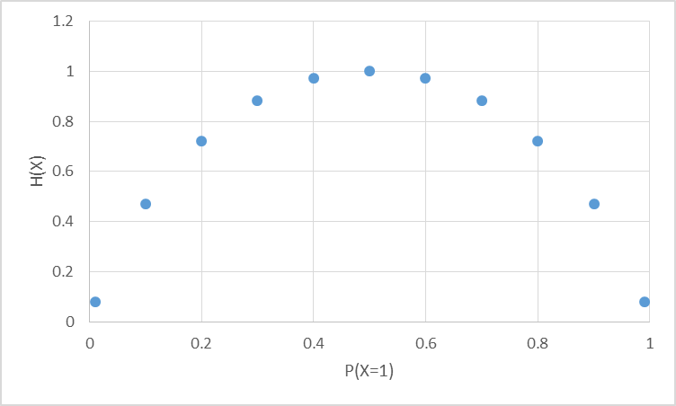
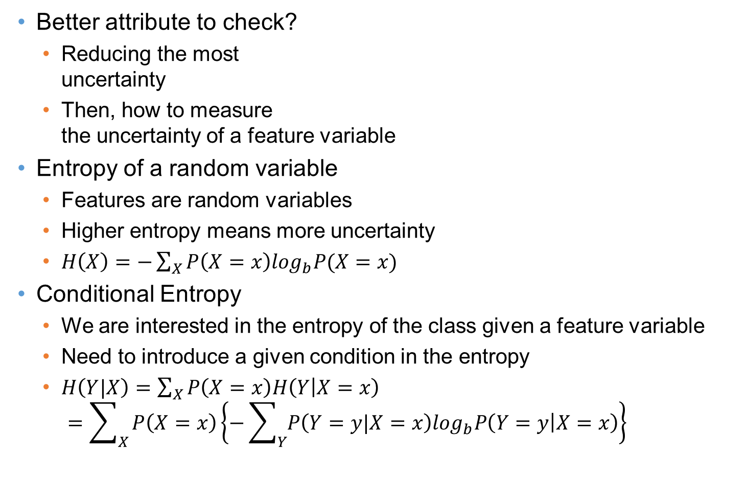
Entropy
Most random case
Better attribute to check?
Reducing the most uncertainty
Then, how to measure the uncertainty of a feature variable
Entropy of a random variable
Features are random variables
Higher entropy means more uncertainty
$H\left(X\right)=−\sum_{X}{P\left(X=x\right)\log_{b}P(X=x)}$
Conditional Entropy
We are interested in the entropy of the class given a feature variable
Need to introduce a given condition in the entropy
$H\left(Y|X\right)=\sum_{X}{P\left(X=x\right)H\left(Y | X=x\right)}$ $=\sum_{X}{P\left(X=x\right)\left\{−\sum_{Y}{P\left(Y=y|X=x\right)\log_{b}P\left(Y=y | X=x\right)}\right\}}$
All instances are X=0
All instances are X=1

Slide 14
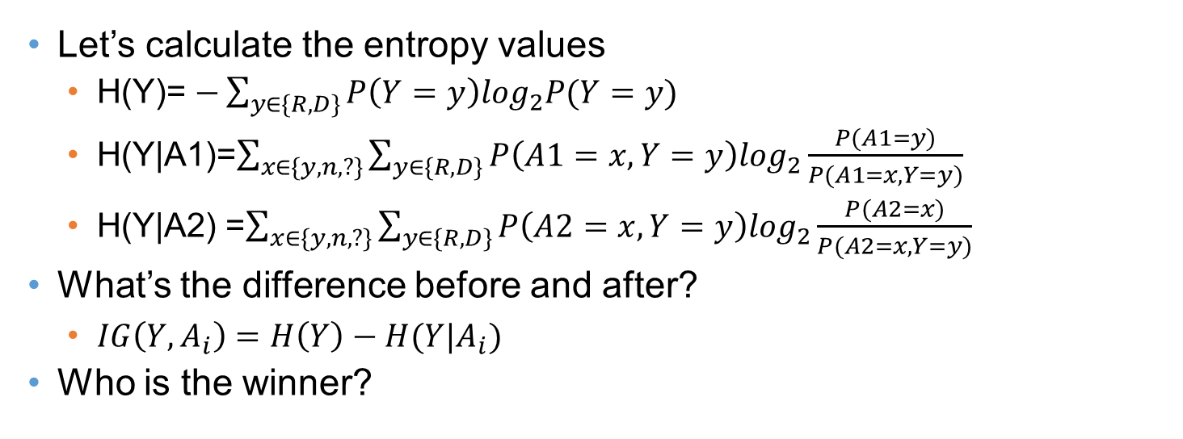
Information Gain
Entropy Before Decision Node
A1 (168R,267D)
A2 (168R,267D)
y
n
?
y
n
?
31R,156D
134R,102D
3R,9D
75R,120D
73R,119D
20R,28D
Entropy After Decision Node A1
Entropy After Decision Node A9
Let’s calculate the entropy values
H(Y)= $−\sum_{y∈\{R,D\}}{P\left(Y=y\right)\log_{2}P(Y=y)}$
H(Y|A1)=$\sum_{x∈\{y,n,?\}}{\sum_{y∈\{R,D\}}{P\left(A1=x,Y=y\right)\log_{2}\frac{P(A1=y)}{P(A1=x,Y=y)}}}$
H(Y|A2) =$\sum_{x∈\{y,n,?\}}{\sum_{y∈\{R,D\}}{P\left(A2=x,Y=y\right)\log_{2}\frac{P(A2=x)}{P(A2=x,Y=y)}}}$
What’s the difference before and after?
$IG\left(Y,A_{i}\right)=H\left(Y\right)−H(Y|A_{i})$
Who is the winner?

Slide 15
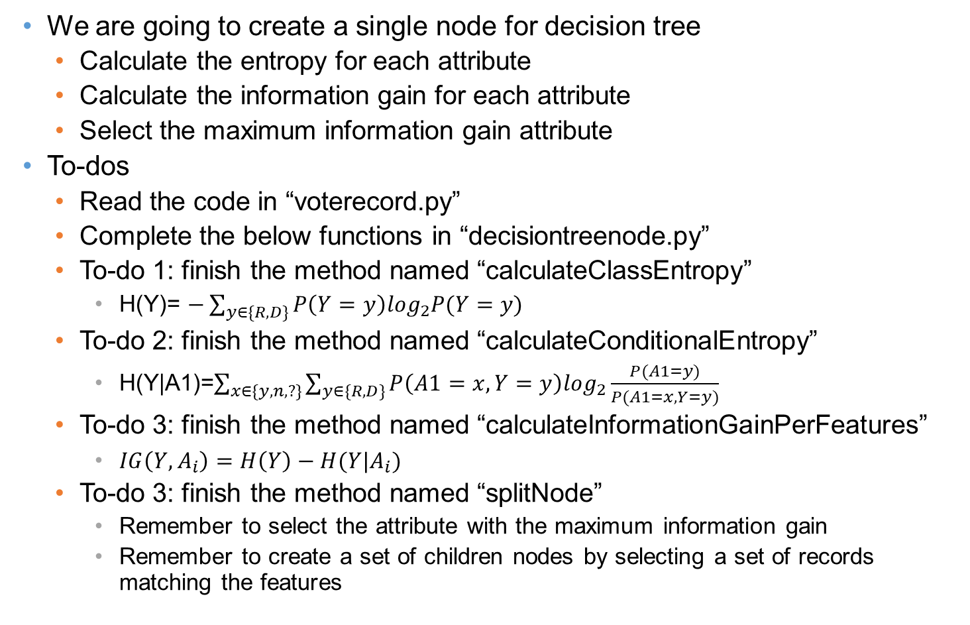
To-Dos
We are going to create a single node for decision tree
Calculate the entropy for each attribute
Calculate the information gain for each attribute
Select the maximum information gain attribute
To-dos
Read the code in “voterecord.py”
Complete the below functions in “decisiontreenode.py”
To-do 1: finish the method named “calculateClassEntropy”
H(Y)= $−\sum_{y∈\{R,D\}}{P\left(Y=y\right)\log_{2}P(Y=y)}$
To-do 2: finish the method named “calculateConditionalEntropy”
H(Y|A1)=$\sum_{x∈\{y,n,?\}}{\sum_{y∈\{R,D\}}{P\left(A1=x,Y=y\right)\log_{2}\frac{P(A1=y)}{P(A1=x,Y=y)}}}$
To-do 3: finish the method named “calculateInformationGainPerFeatures”
$IG\left(Y,A_{i}\right)=H\left(Y\right)−H(Y|A_{i})$
To-do 3: finish the method named “splitNode”
Remember to select the attribute with the maximum information gain
Remember to create a set of children nodes by selecting a set of records matching the features

Slide 16
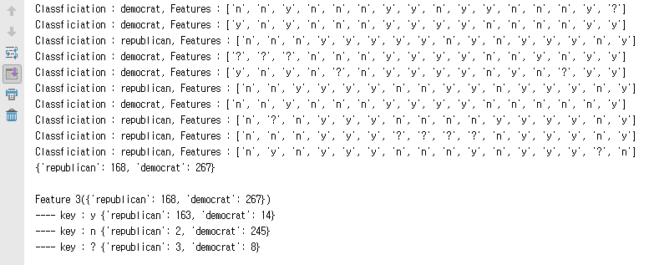
Execution Result
When you complete the codes, you are expected to see the below results.
Execute ‘decisiontreenode.py’

